Slide 1
SAMBA SERVER
STEPS TO CONFIGURE SAMBA SERVER
Submitted By – Sahil Prateek Tigga, Saksham Shakya

Slide 2
Mount CD1 and install following three packages:
Samba-common //(to share on cross platform)
Samba //(main samba config file)
Samba-client //(for samba client)
Create a new user (for eg. Here its samba1), provide the user password and also samba password to the user as follows:

Slide 3
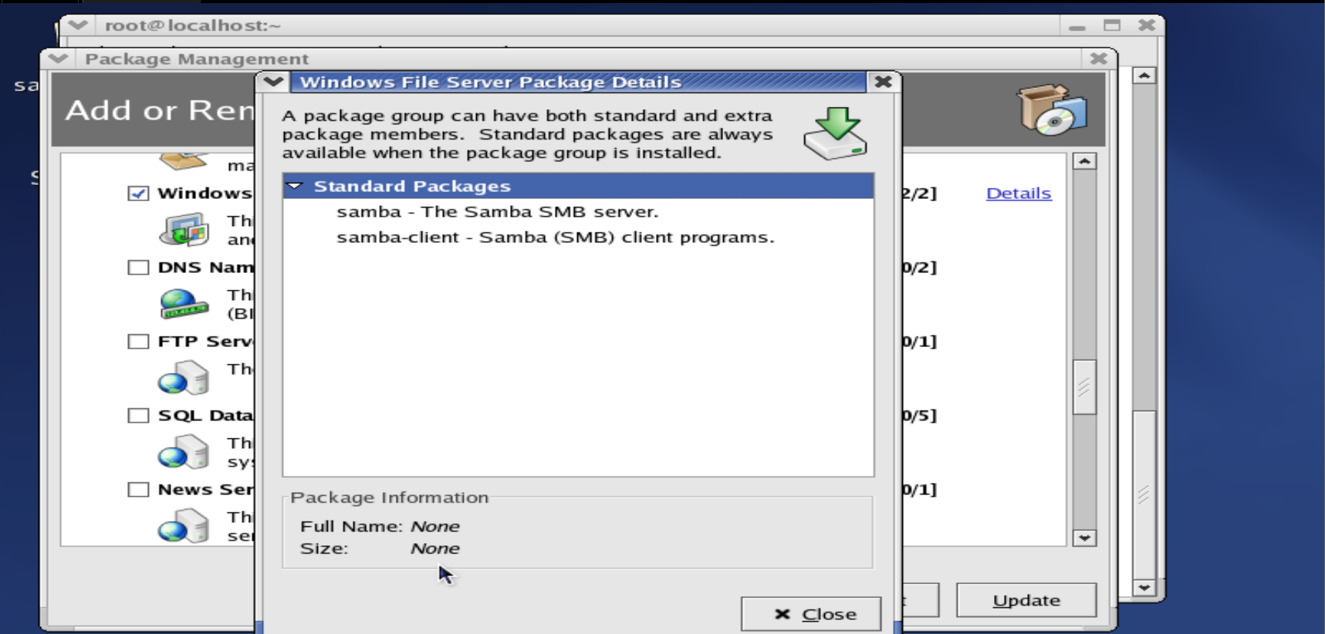
redhat-config-packages : to install SAMBA

Slide 4
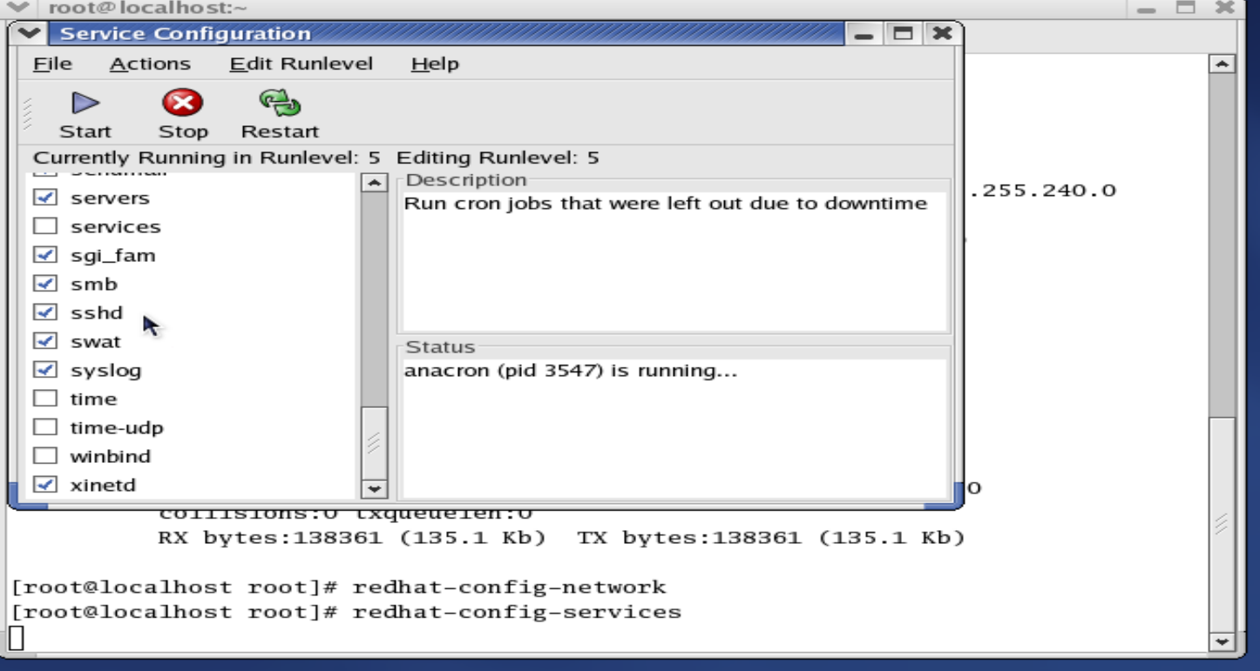
Start SAMBA Server: redhat-config-services

Slide 5
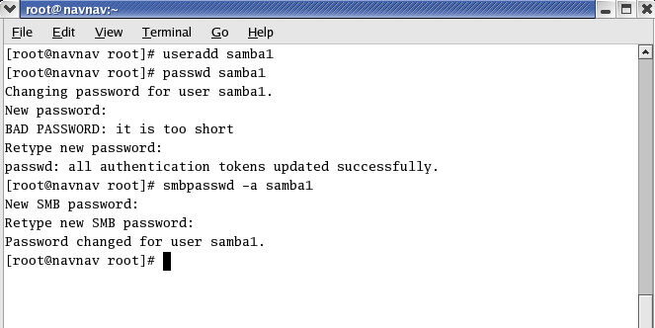

Slide 6
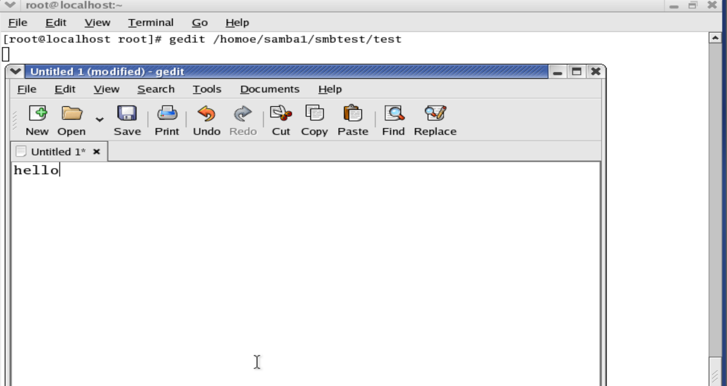
Now create a directory,file and add content to that as follows

Slide 7
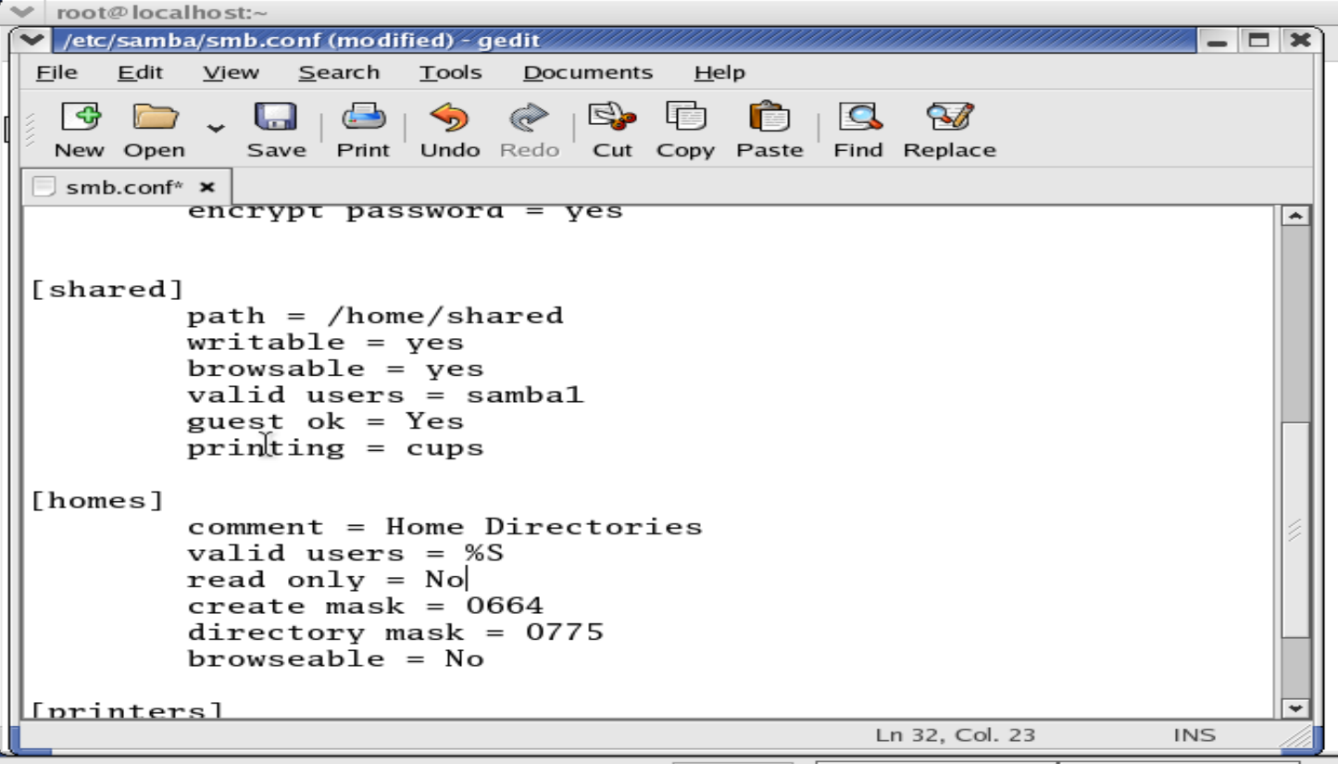
gedit /etc/samba/smb.conf - to edit

Slide 8
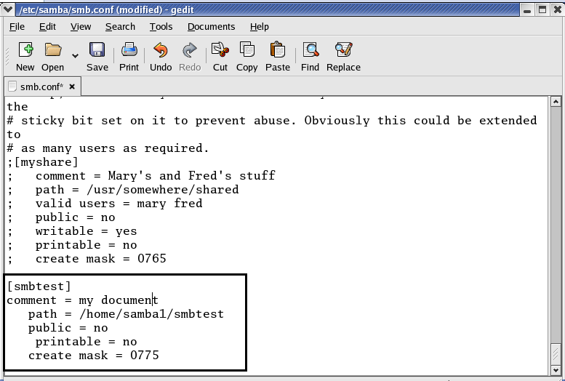
edit the highlighted part in the samba configuration

Slide 9
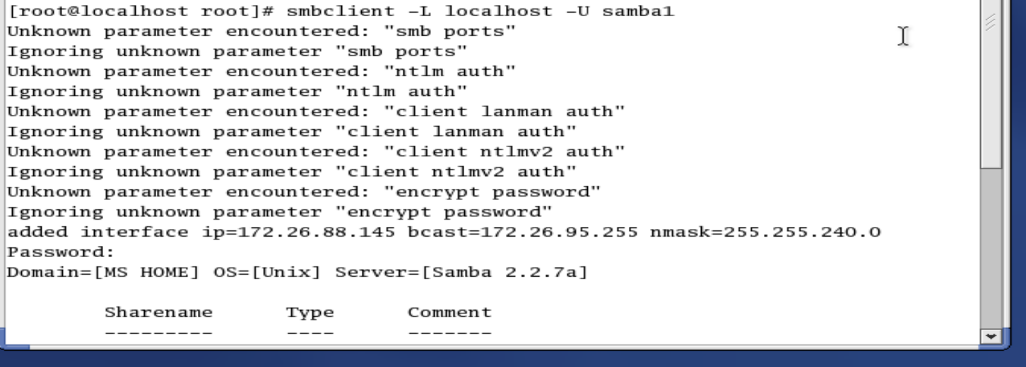

Slide 10
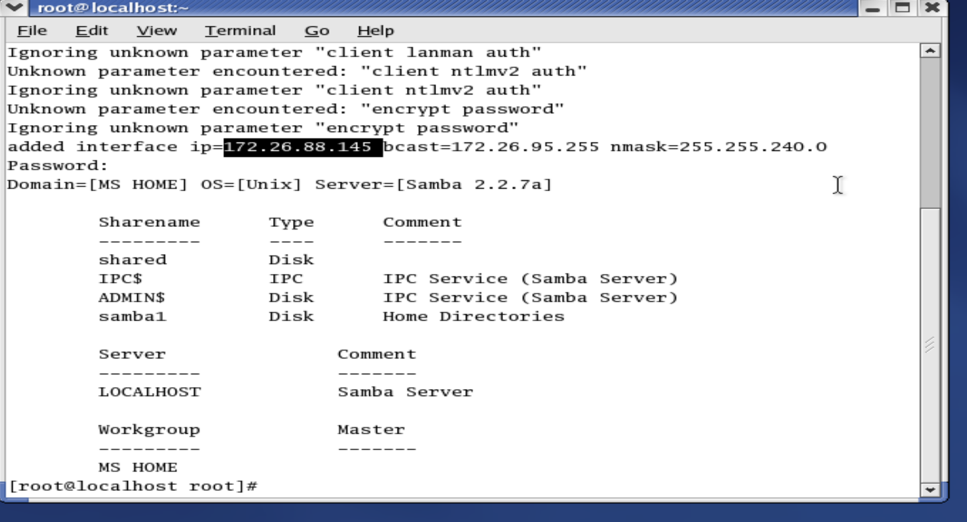

Slide 11
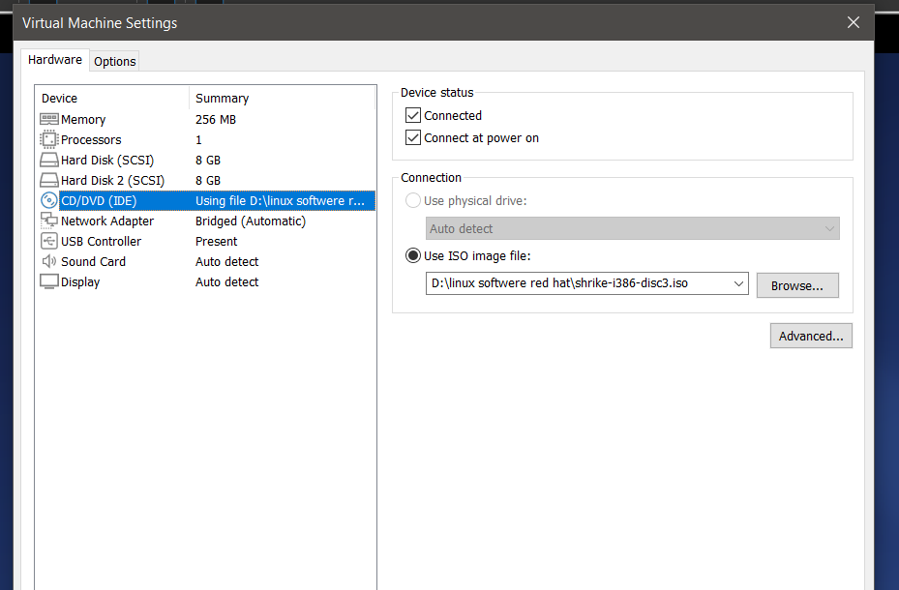

Slide 12
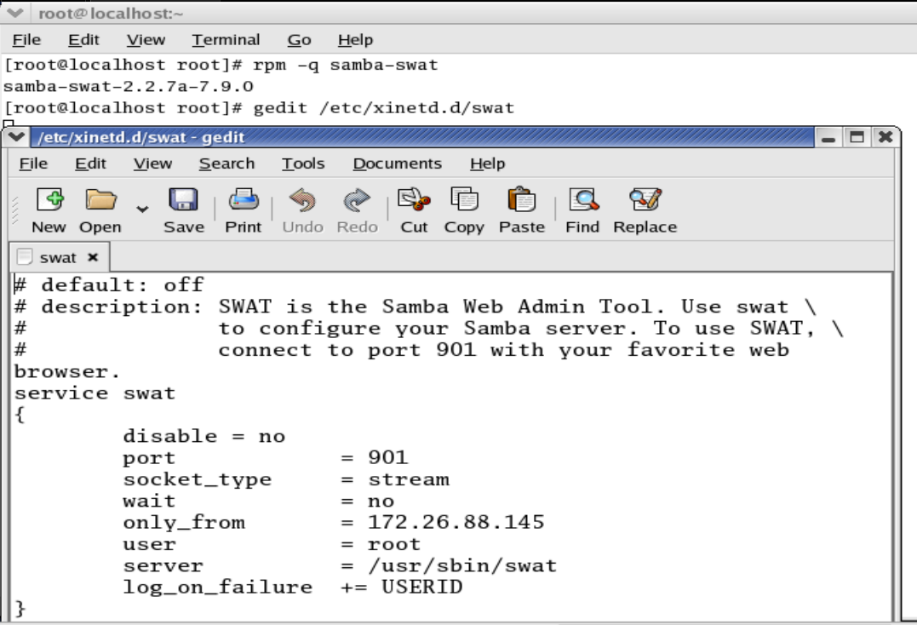
SAMBA – SWAT (Samba Web Admin Tool)
Follow the process of samba.
Mount CD3 and install samba-swat package
Make following changes to samba swat configuration file (xinetd.d/swat). Write IP address of samba server as the value of only_from.

Slide 13
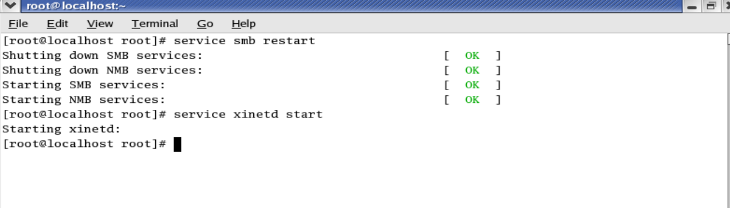
Start the service of samba (smb) and samba swat (using xinetd) as follows:
Open browser and type the URL as
http:// IPADDRESS of samba server : Port number
For Eg: here its http://192.168.192.150:901
And press enter. You will see a prompt box. Enter samba user name and samba password here and click on OK.

Slide 14
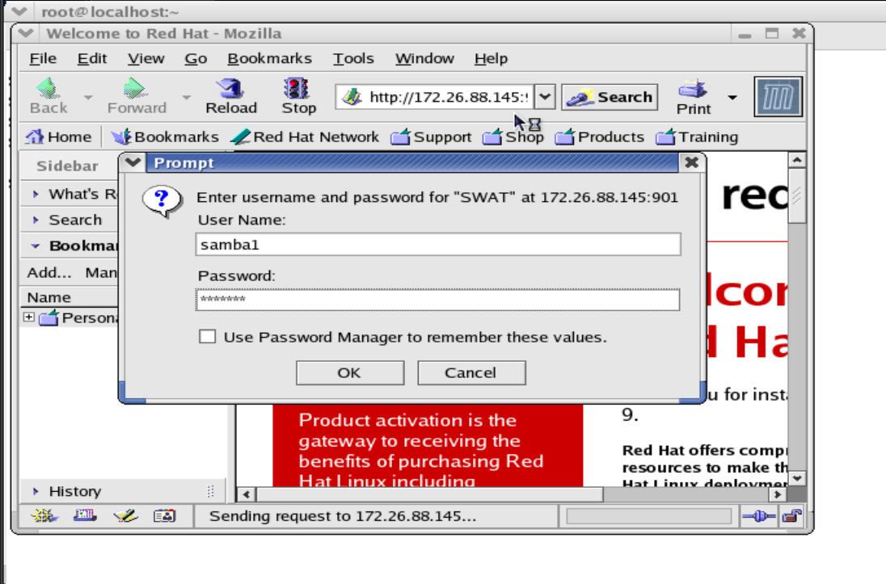

Slide 15
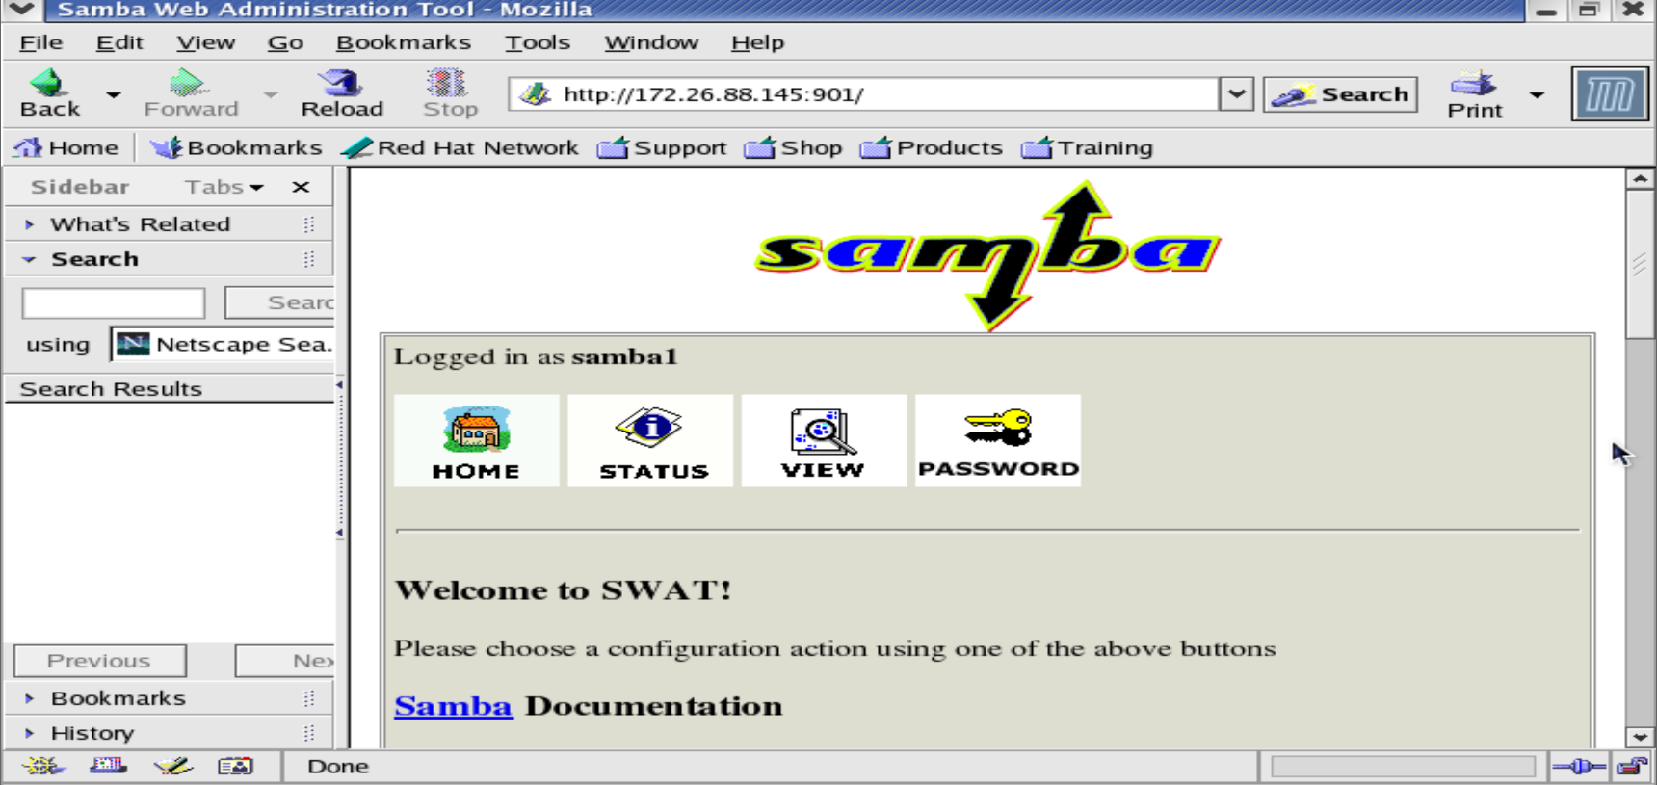

Slide 16
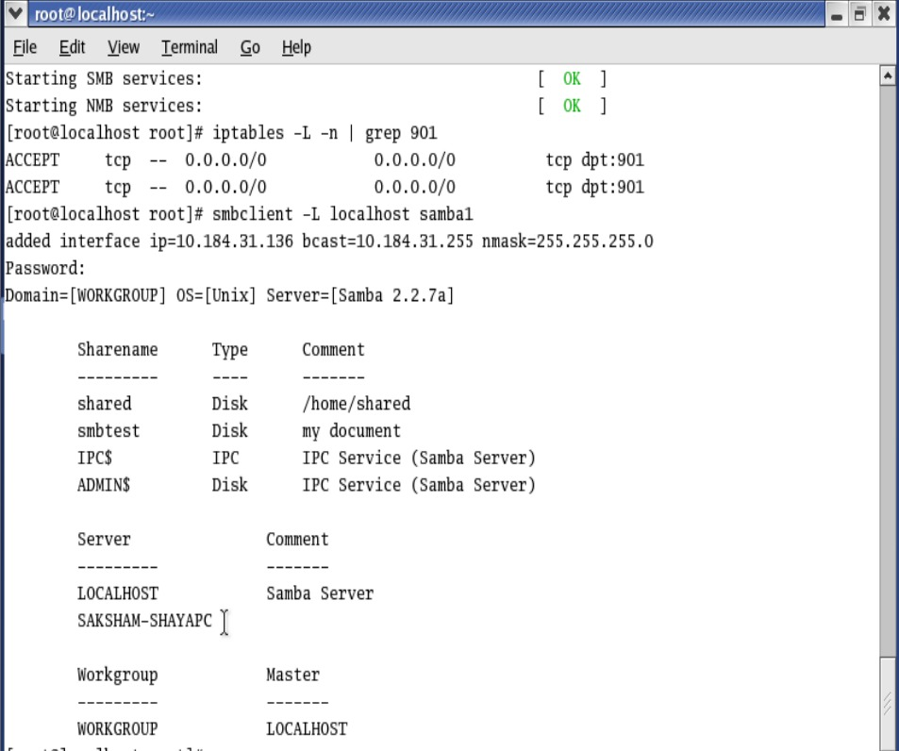
Now in terminal type- iptables -L -n | grep 901 To check whether any firewall rule exists related to port 901.
Then restart smb and xinetd.

Slide 17
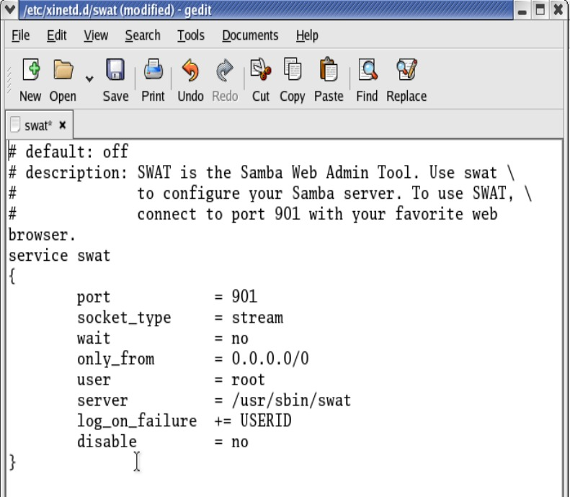
again type- gedit /etc/xinetd.d/swat to edit the “only_from” and set it to 0.0.0.0/0

Slide 18
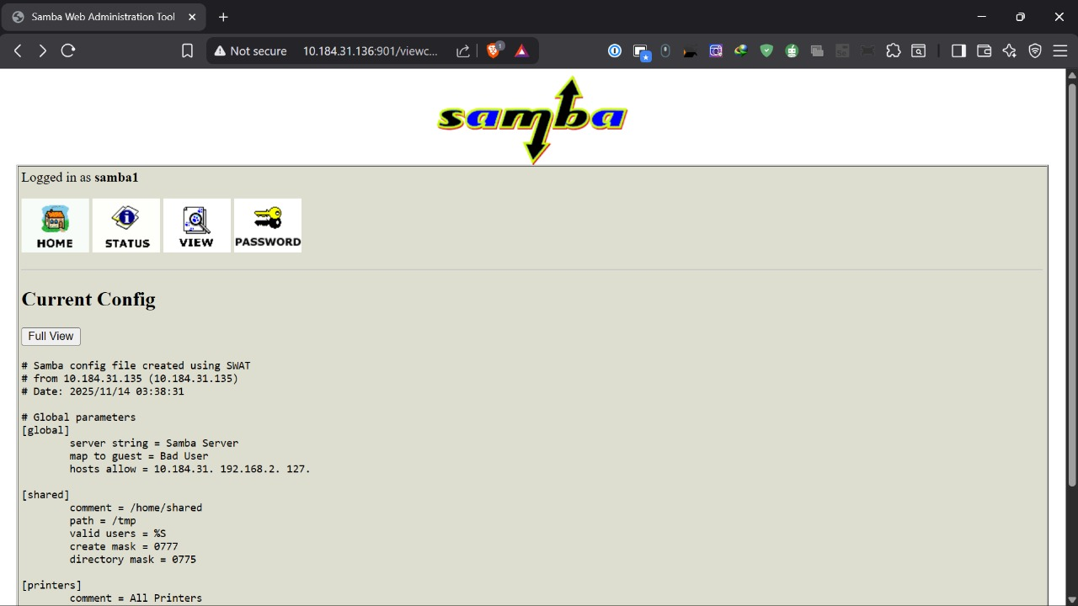
Now open any browser on the PC and type the ip address of the samba user created;eg-172.26.88.145 Give the username and password of the samba user . This will finally open the “Samba server message” .
This show the crossplatform connection between the Linux Samba Server and the original PC.

